Slide 1


On AI-Driven Privacy Protection: A Study on AI-based Solutions using
Face Blurring Techniques
Done By: Sara Amjad Sabih Anabtawi 212071
Supervised by: Doctor Amr Ghoneim

Slide 2
1
Introduction
2
Problem Statement
3
Scope and Objectives
4
State of the art
Table of content
5
Proposed Solution
6
Targeted users
7
Datasets
8
Pipeline
9
Preprocessing
10
Blurring Techniques
11
Testing and Evaluation
12
Results
13
Challenges and Limitations
14
Conclusion

Slide 3
01
Introduction
In the digital age, the vast circulation of images online raises significant privacy concerns.
The project focuses on developing an efficient AI system for robust facial detection and blurring, making faces unrecognizable to advanced AI models like YOLO and MobileNet. Multiple blurring techniques may be applied to ensure the individual privacy is protected by blurring faces of non- consenting individuals.
Despite the blurring, image quality remains intact, maintaining integrity while enhancing digital privacy.
This practical tool will empower people to control their online identities, reduce unauthorized face visibility, and increase community safety. The project's outcomes will advance AI-driven privacy protection strategies, setting new standards in this critical field.

Slide 4

Many platforms allow the publication of images without consent, increasing risks such as :
Identity theft
Cyberbullying
Reputational damage
Problem Statement

Slide 5

Scope:
Image Input (as various types)
Multiple Face Detection and Recognition
Selective Face Blurring
Preserve the quality
Objective:
Privacy & Utility Preservation
Scope and Objective

Slide 6

State of the art

Slide 7
Paper | Year | Approach | Accuracy
2 | 2018 | Haar Cascade R-CNN | 83.8% 89.6%
3 | 2016 | Haar classifier (Detection) PCA (Recognition) | 98.18% 93.33%
4 | 2015 | VGG-16 and VGG-19 | 98.95% 97.3%
5 | 2019 | GoogLeNet | 88%
1 | 2024 | CNN | 99.67%

Slide 8

Proposed Solution

Slide 9
Models For Face Detection :
Yolov5
Yolov8
Models For Face Recognition (Selective Blurring) :
MobileNet
Yolov5
Yolov8
Blurring techniques :
Gaussian Blur
Median Blur
Box Filter Blur
Mean Shift Filtering
Radial Blur
Motion Blur
GrabCut/Guassian Blur
Models For Face Recognition(on blurred faces):
MobileNet
Yolov5
Yolov8

Slide 10

Businesses: Protecting Customer Privacy in Marketing Materials, and other Visual Content.
Individuals: Sharing Personal Photos on Social Media without Exposing the Identities of others Captured in the background.
Journalists: Blurring Faces(sources) in Sensitive Interviews or Investigations.
Targeted Users

Slide 11

Datasets

Slide 12
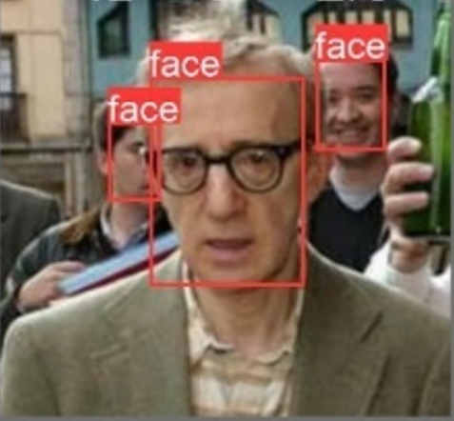
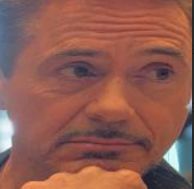
LFW(Labeled Faces in the Wild) Dataset
This Dataset includes annotated images with bounding boxes around faces, making it suitable for training YOLO models for face detection.
Images: 13,231 images of faces, each labeled with the person's name.
Bounding Boxes: Each image is annotated with bounding boxes that indicate the position of the face, which is essential for training YOLO models.
Variability: The images were taken in uncontrolled environments with various lighting conditions, poses, and backgrounds, providing a robust dataset for face detection.
Avengers Dataset
The Avengers dataset contains images of six characters from the Avengers movie series. This dataset was labelled but is no annotated with bounding boxes and wasn’t divided.
Images: 781 images of cropped faces
Classes:
Tony Stark (Robert Downey Jr.)
Steve Rogers (Chris Evans)
Natasha Romanoff (Scarlett Johansson)
Bruce Banner (Mark Ruffalo)
Clint Barton (Jeremy Renner)
Thor (Chris Hemsworth)

Slide 13

Generic Pipeline

Slide 14
1
2
3
Input image
Pre-processing
Face detection model
4
5
6
Pre-processing
Face recognition model
Face blurring techniques
7
8
Face recognition model
Output blurred image

Slide 15

Pre-Processing

Slide 16
Face Recognition Model Yolov5/Yolov8 Preprocessing
load and convert images to RGB format.
Load the Utilized pretrained YOLOv5/Yolov8 model, that was fine-tuned on the LFW dataset for face detection.
Detecting Faces and Generating Bounding Boxes
Save the annotations of each image
Draw bounding box on each image
Convert the annotations to yolo format
divide a dataset of images and their corresponding bounding box labels into training and validation sets using an 80:30 ratio
Move files so that the images are in a folder of 2 Folders (train and val) and in each folder it has 6 sub folders(6 classes) and in each of these folders there will be two sub folders (image and label).
Create Yaml File

Slide 17
Face Recognition Model MobileNet Preprocessing
Load and convert images to RGB format.
Resize images to 224x224 Pixels
Normalize images
Encode Classes using a OneHotEncoder
Split Dataset into Training and testing using
a 70:30 ratio
Adding New Top Layers such as global average pooling, a few dense layers with ReLU activation, batch normalization, dropout for regularization, and a SoftMax layer for classification.

Slide 18

Blurring Techniques Sample

Slide 19
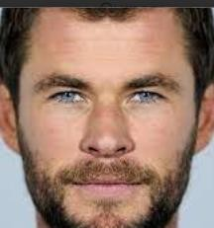
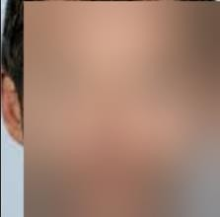
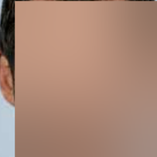
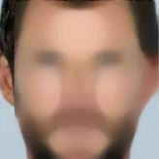
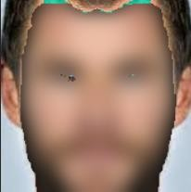
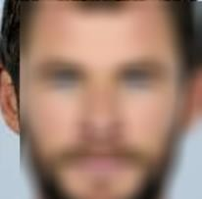
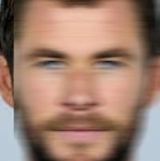
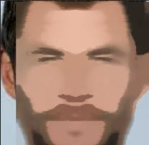
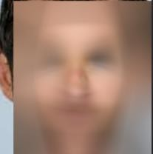
Original Image
Gaussian Blur
All Techniques
Median Blur
GrabCut/Gaussian Blur
Box Filter Blur
Motion Blur
Radial Blur
Mean Shift Filtering

Slide 20

Testing and Evaluation

Slide 21
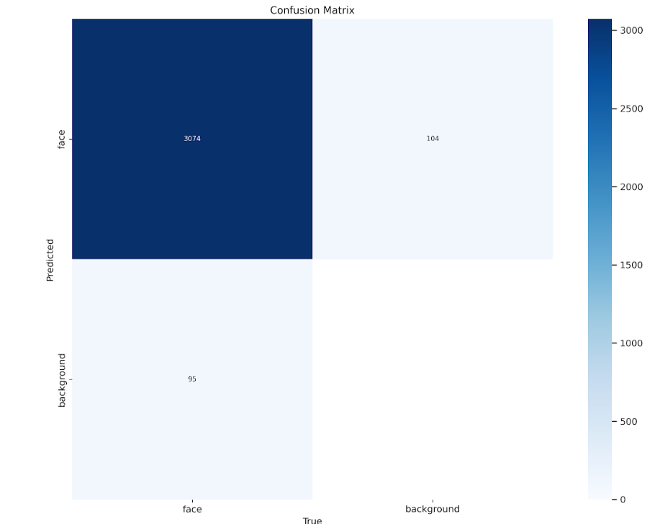
1. YOLOV8 as a Face Detection Model(15 epochs) :

Slide 22
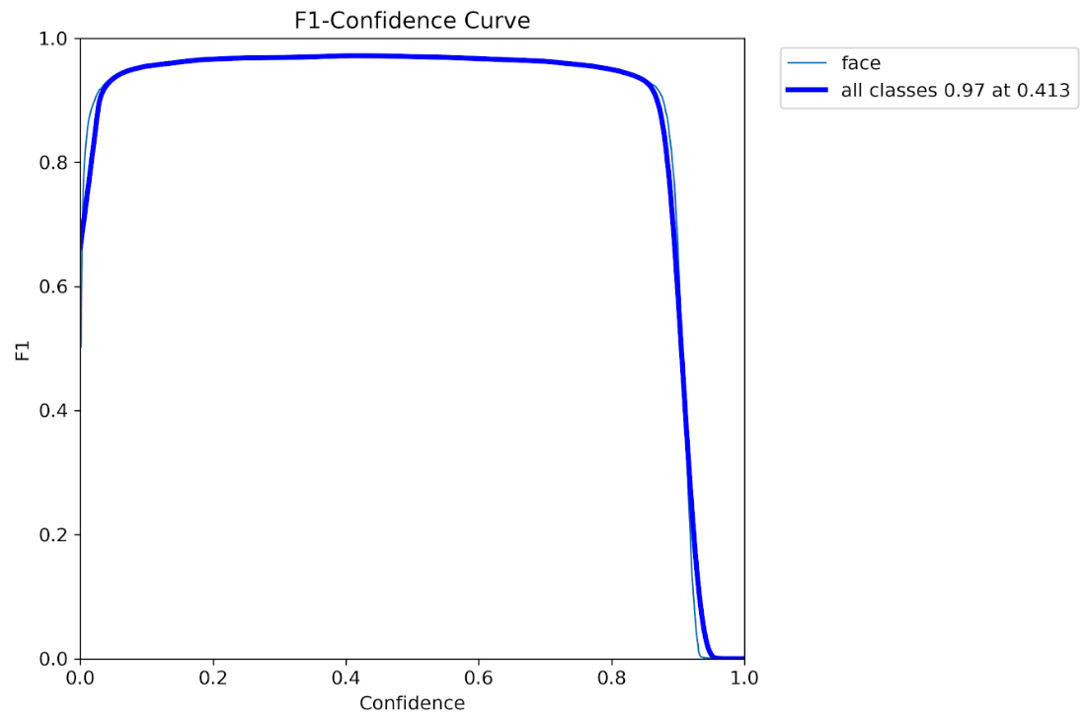
1. YOLOV8 as a Face Detection Model(15 epochs) :

Slide 23
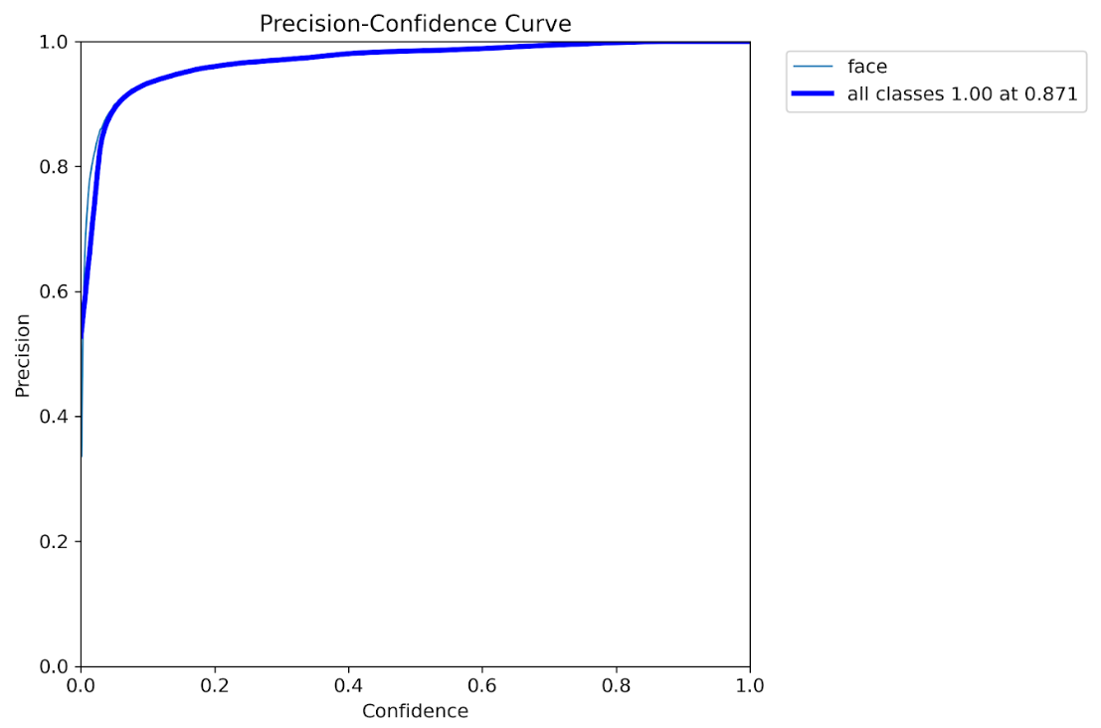
1. YOLOV8 as a Face Detection Model(15 epochs) :

Slide 24
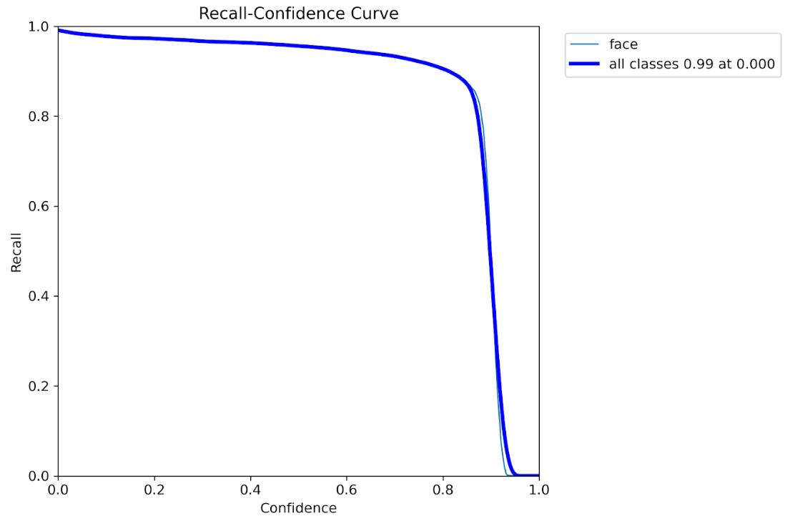
1. YOLOV8 as a Face Detection Model(15 epochs) :

Slide 25
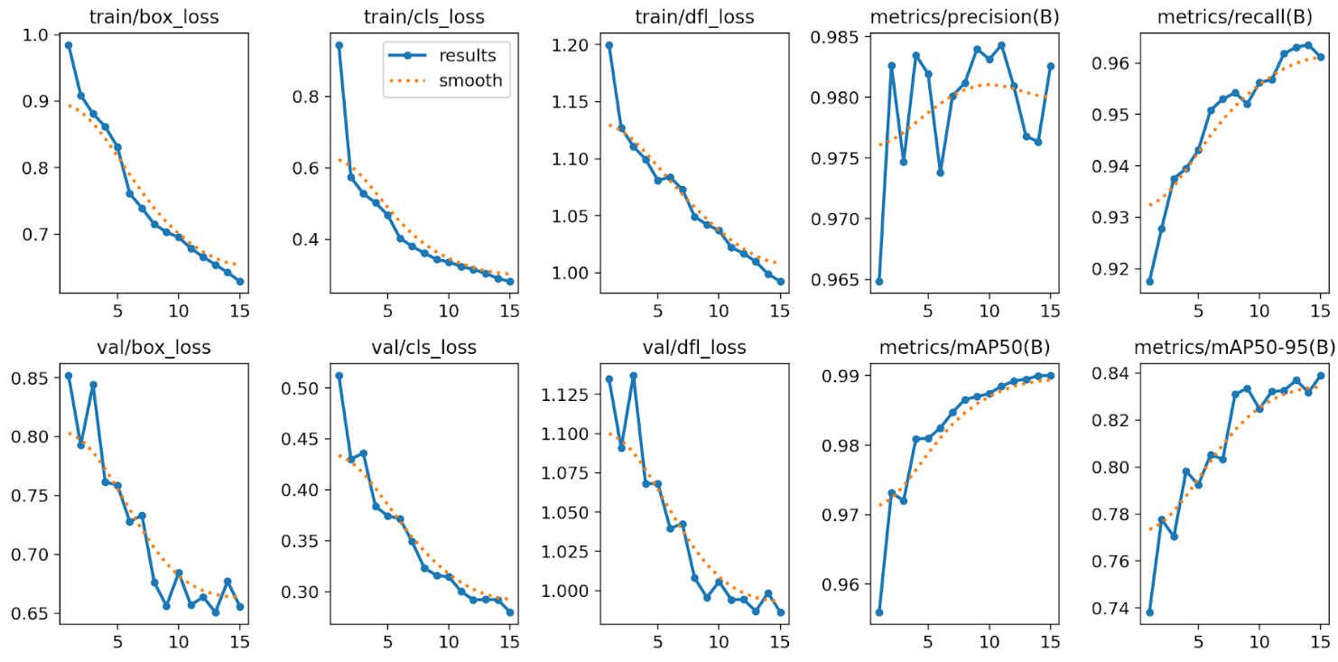
1. YOLOV8 as a Face Detection Model(15 epochs) :

Slide 26
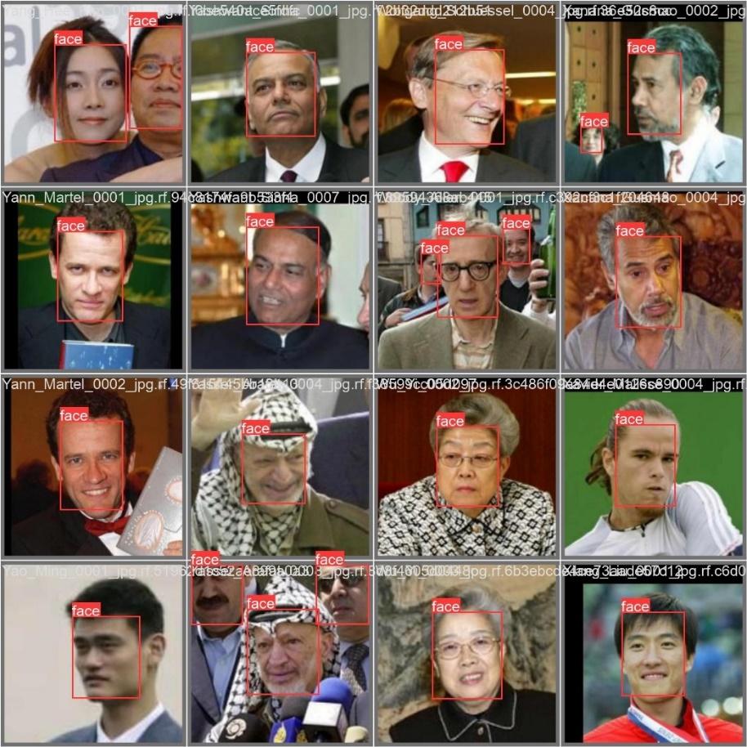
1. YOLOV8 as a Face Detection Model(15 epochs) :
Validation Sample Batch 1 Labels

Slide 27
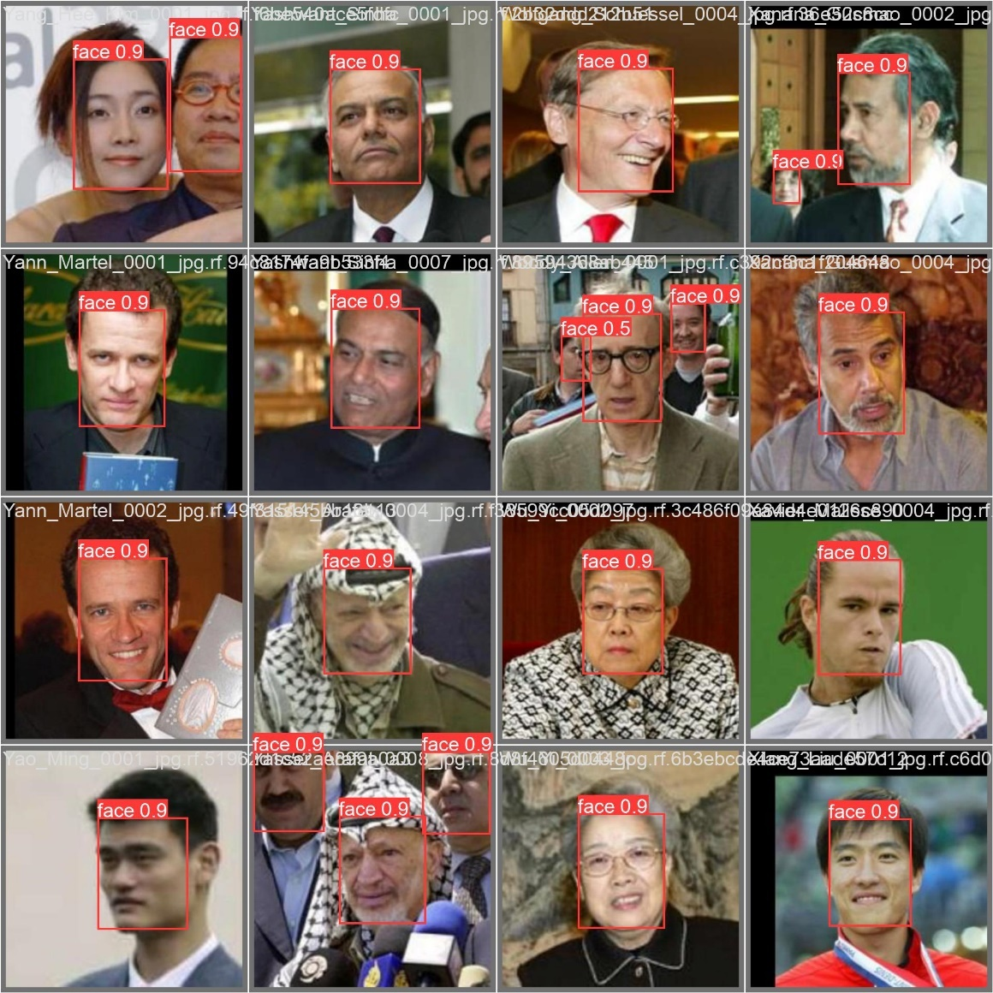
1. YOLOV8 as a Face Detection Model(15 epochs) :
Validation Sample Batch 1 Predictions

Slide 28
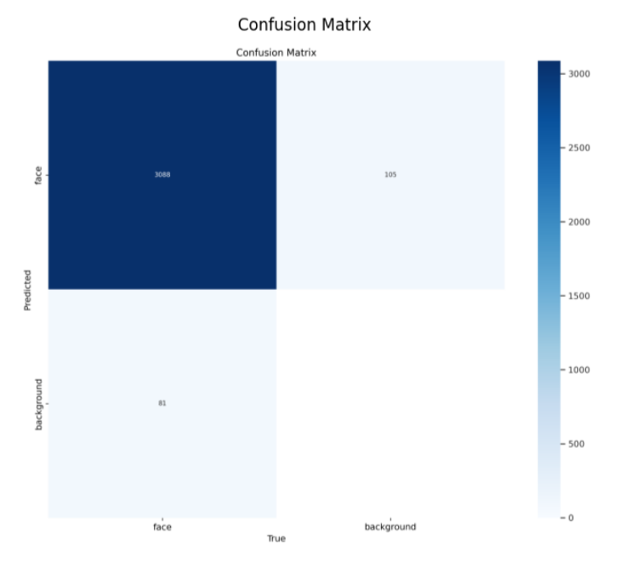
2. YOLOV5 as a Face Detection Model(30 epochs):

Slide 29
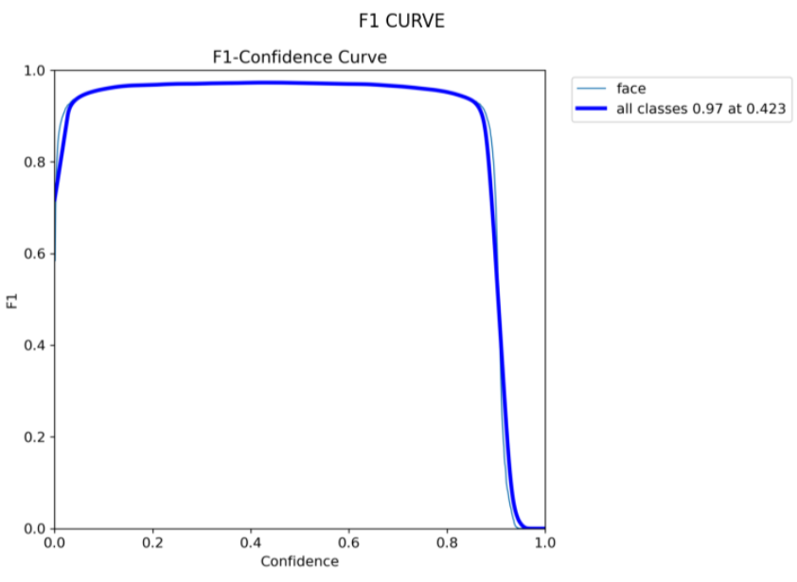
2. YOLOV5 as a Face Detection Model(30 epochs):

Slide 30
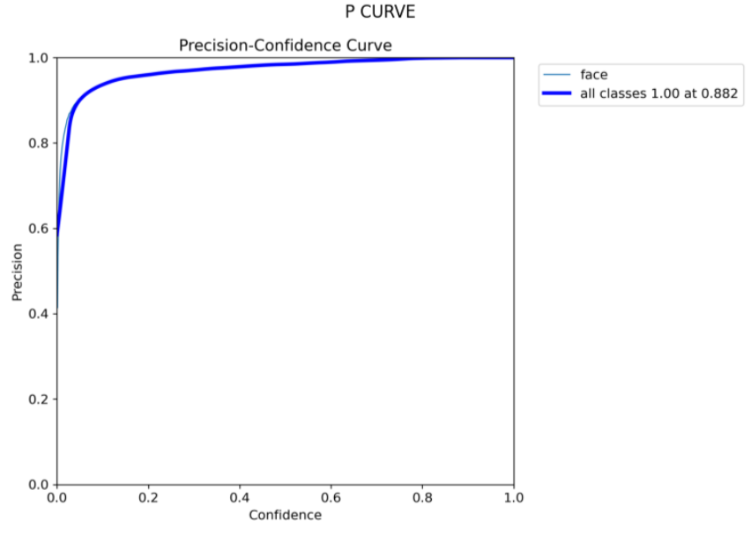
2. YOLOV5 as a Face Detection Model(30 epochs):

Slide 31
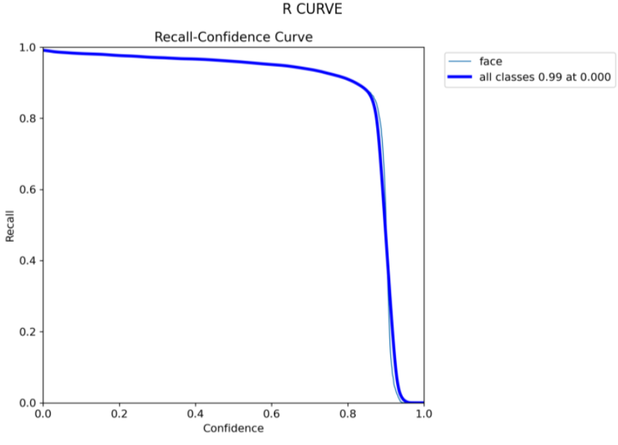
2. YOLOV5 as a Face Detection Model(30 epochs):

Slide 32
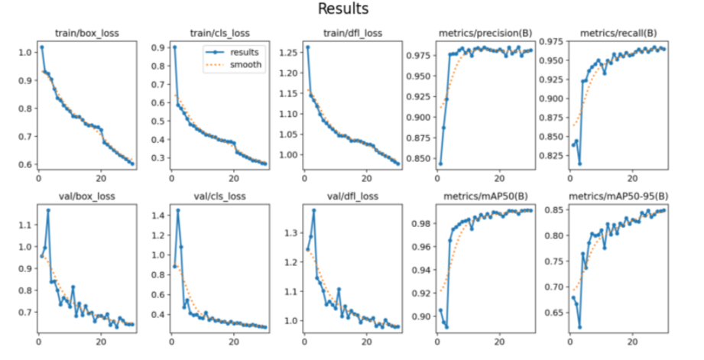
2. YOLOV5 as a Face Detection Model(30 epochs):

Slide 33
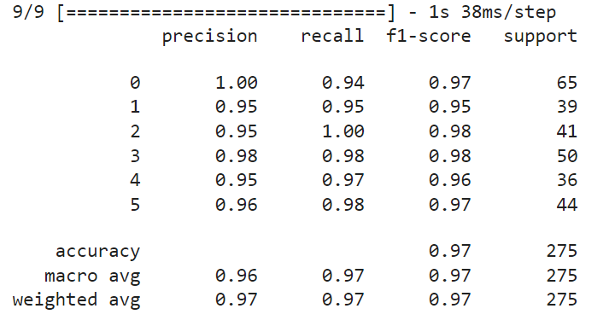
3. MobileNet as a Face Recognition Model(50-35)

Slide 34
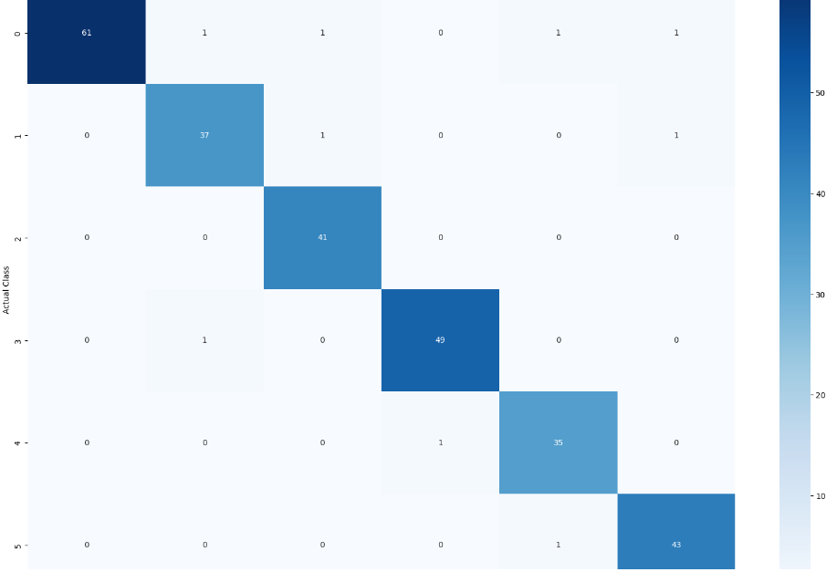
3. MobileNet as a Face Recognition Model
0
1
2
3
4
5

Slide 35
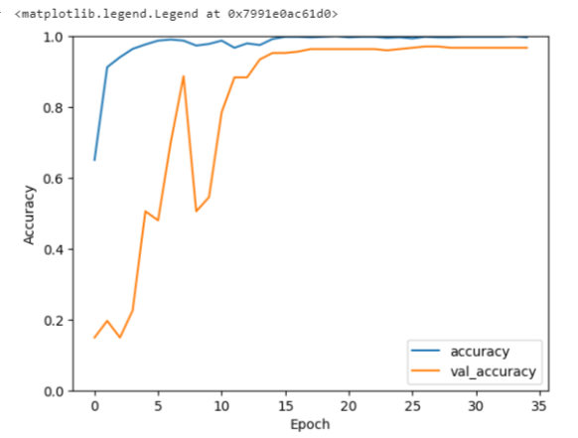
3. MobileNet as a Face Recognition Model

Slide 36
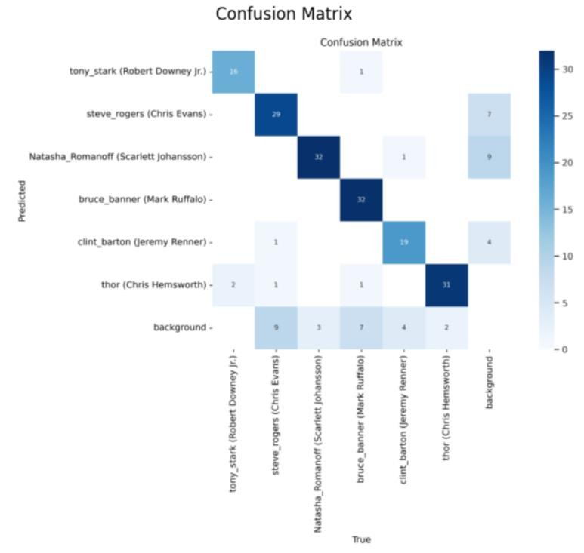
4. YoloV5 as a Face Recognition Model(35 epochs)

Slide 37
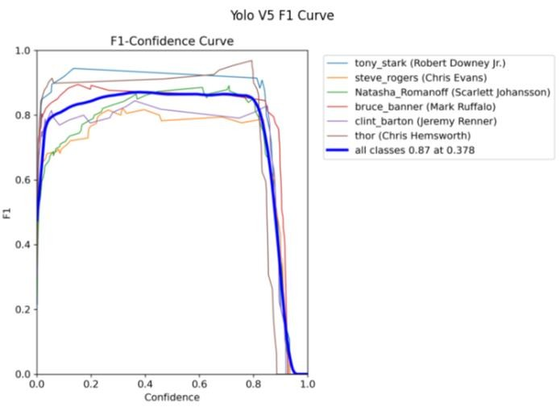
4. YoloV5 as a Face Recognition Model

Slide 38
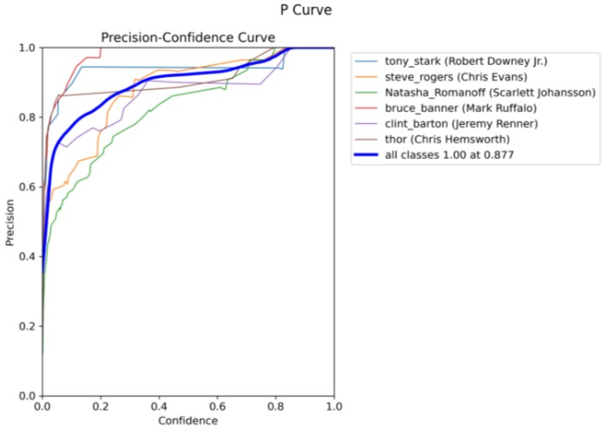
4. YoloV5 as a Face Recognition Model

Slide 39
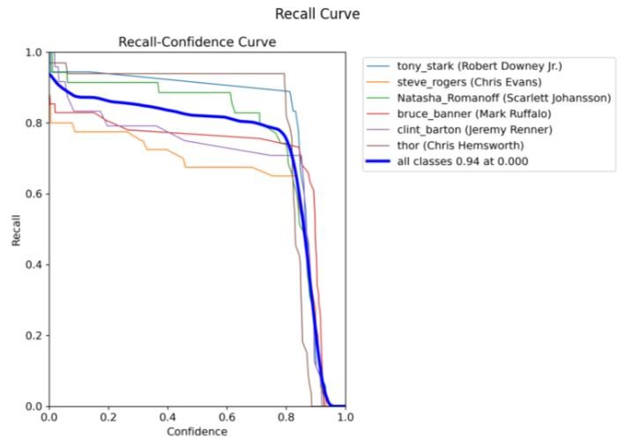
4. YoloV5 as a Face Recognition Model

Slide 40
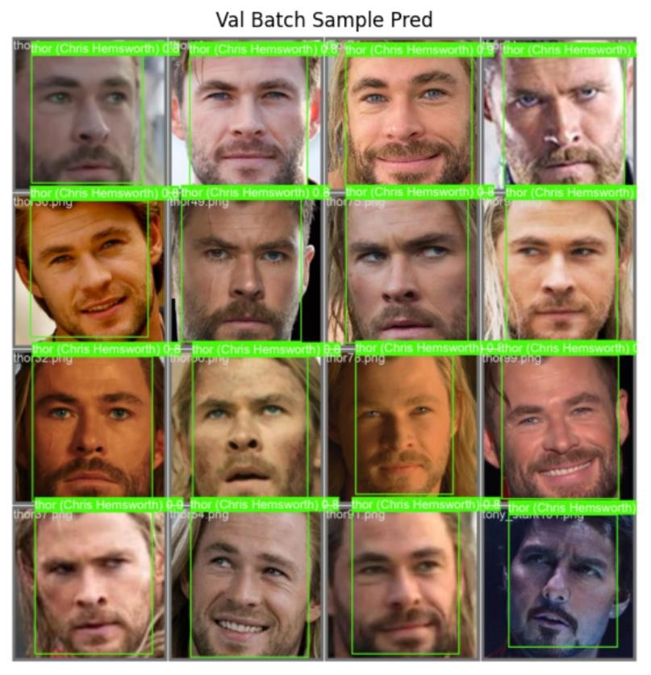
4. YoloV5 as a Face Recognition Model

Slide 41
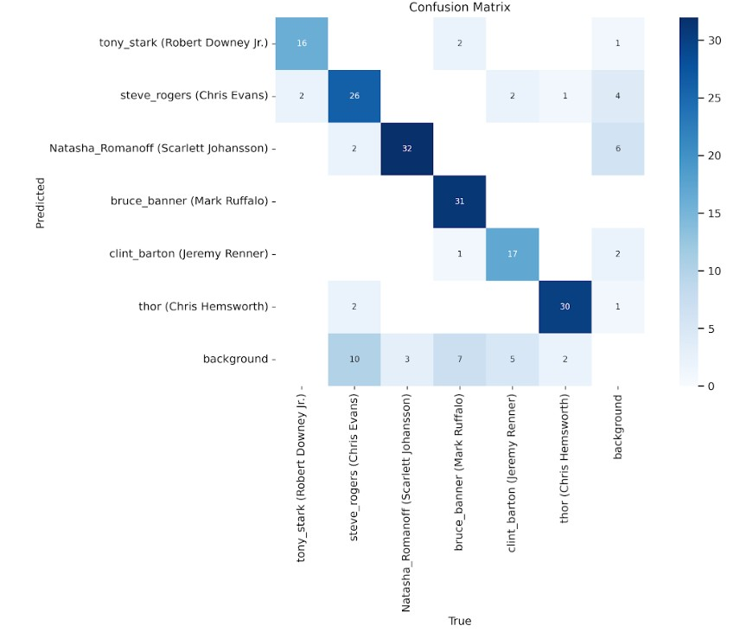
5. YoloV8 as a Face Recognition Model (25 epochs)

Slide 42
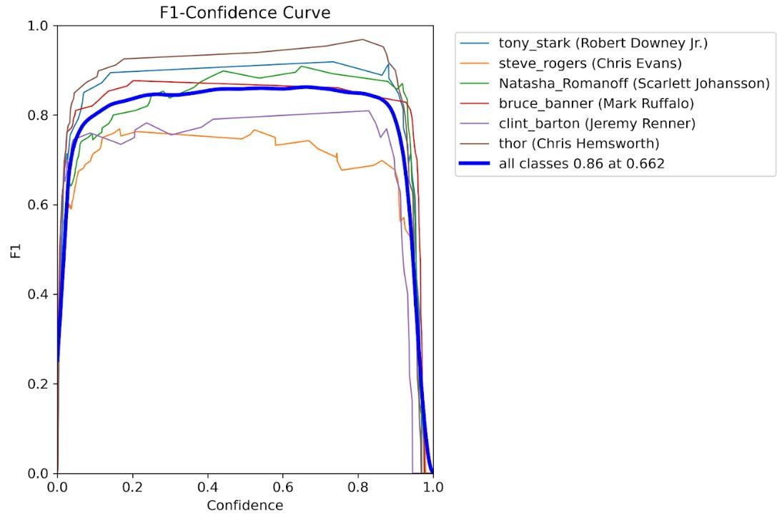
5. YoloV8 as a Face Recognition Model

Slide 43
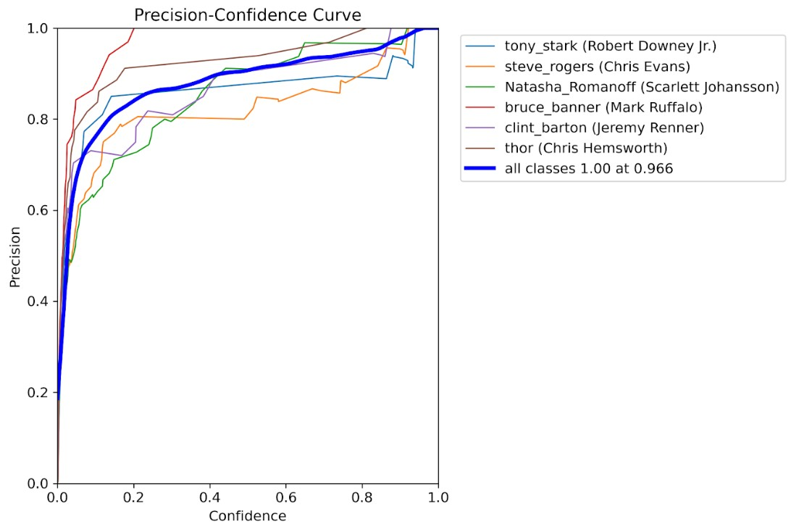
5. YoloV8 as a Face Recognition Model

Slide 44
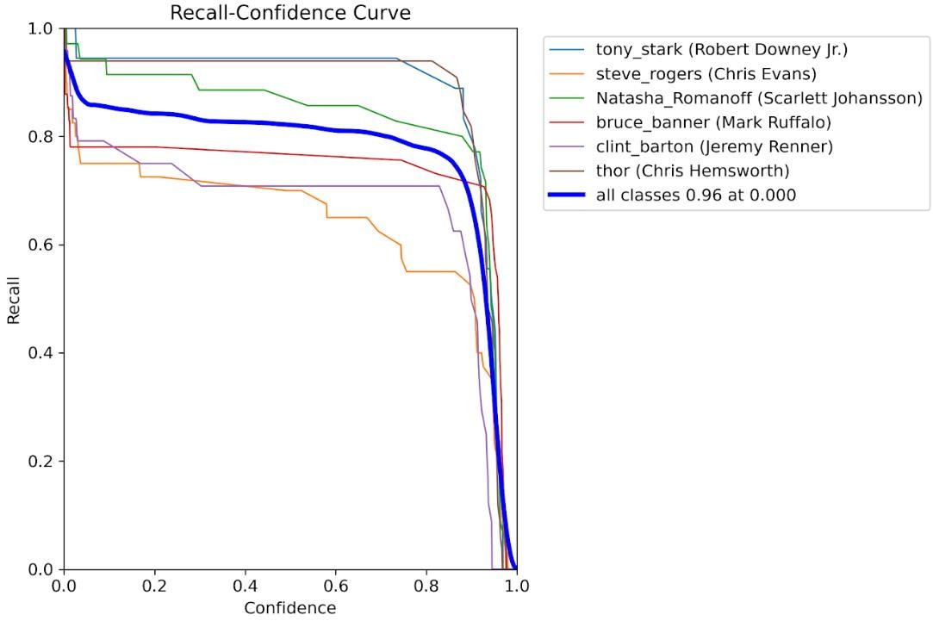
5. YoloV8 as a Face Recognition Model

Slide 45
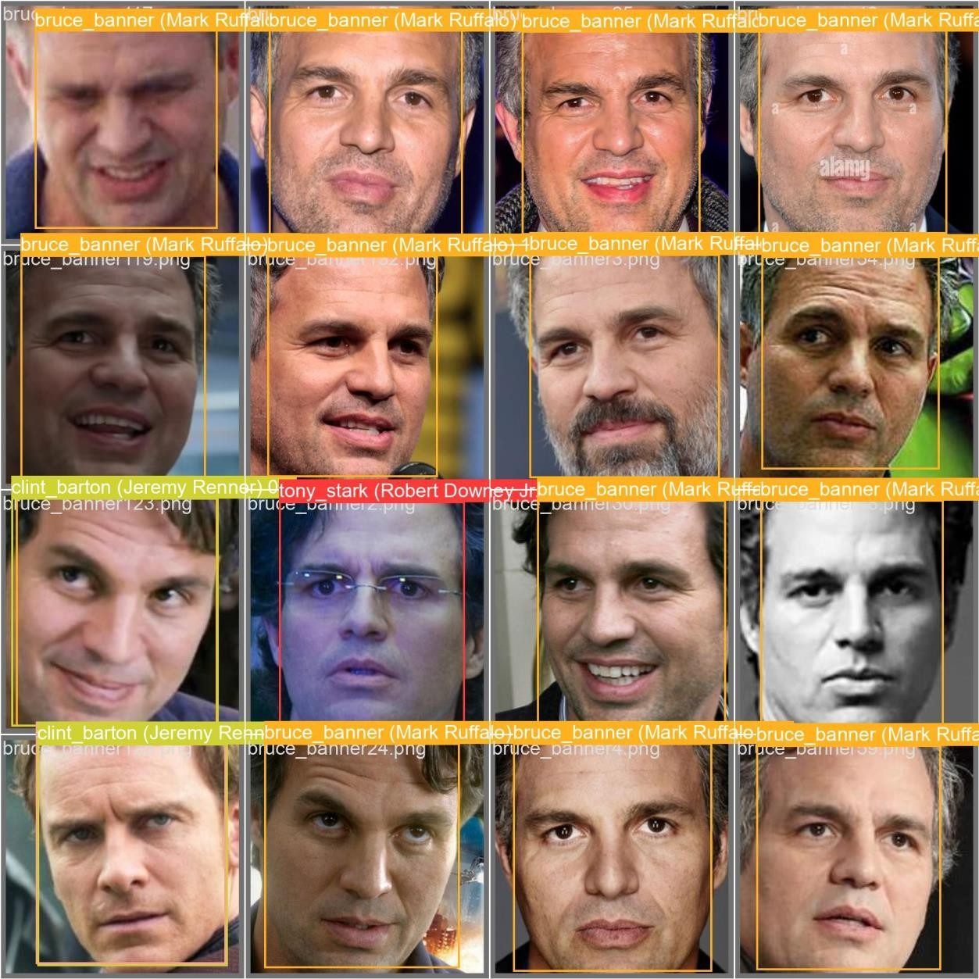
5. YoloV8 as a Face Recognition Model
Validation Predictions Samples

Slide 46

Results

Slide 47
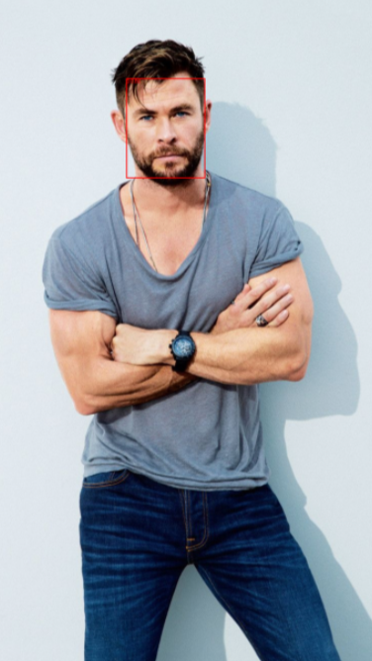
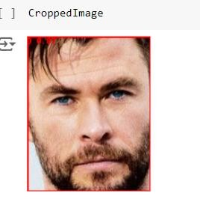
YoloV8 Face Detection and Recognition Models
Results of an imagine with a :
single face

Slide 48
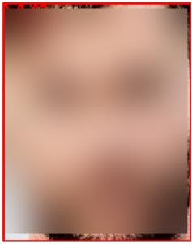
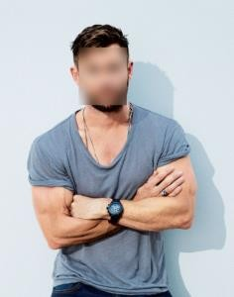
YoloV8 Face Detection and Recognition Models
Results of an imagine with a :
single face

Slide 49
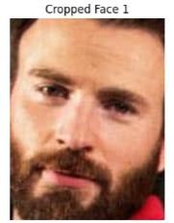
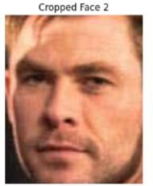
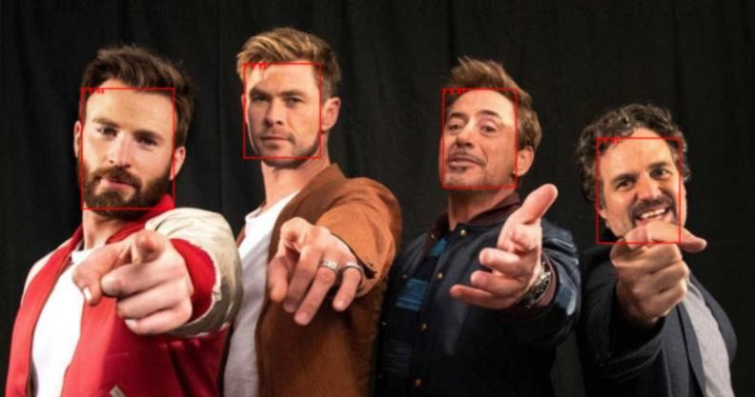
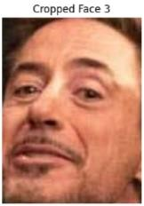
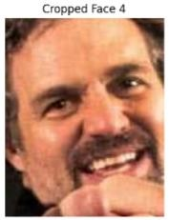
YoloV8 Face Detection and Recognition Models
Results of an imagine with :
Multiple faces

Slide 50
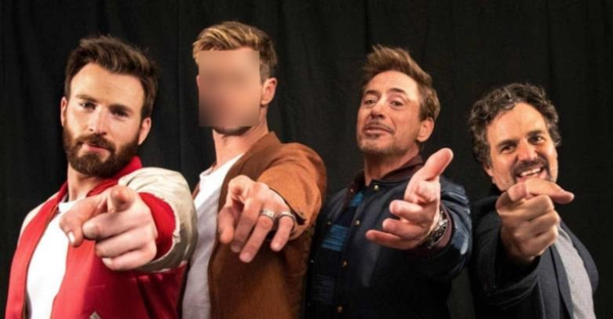
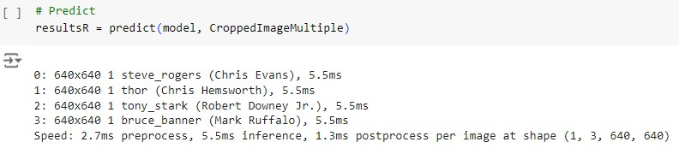
YoloV8 Face Detection and Recognition Models
Results of an imagine with :
Multiple faces

Slide 51
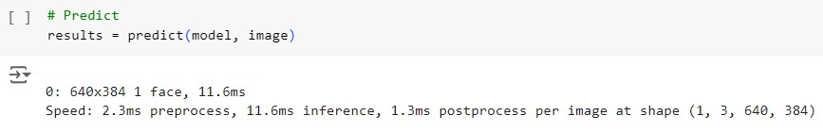
YoloV5 Face Detection and Recognition Models
Results of an imagine with a :
single face

Slide 52
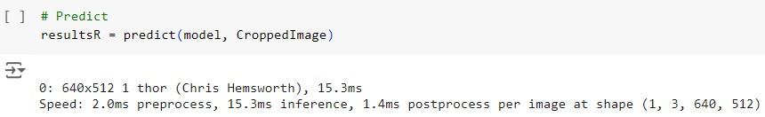
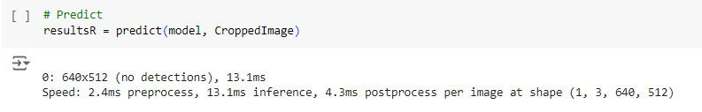
YoloV5 Face Detection and Recognition Models
Results of an imagine with a :
single face

Slide 53




YoloV5 Face Detection and Recognition Models
Results of an imagine with :
Multiple faces

Slide 54


YoloV5 Face Detection and Recognition Models
Results of an imagine with :
Multiple faces

Slide 55



The YOLOV8 For Face Detection and MobileNet for Face Recognition
Results of an imagine with a :
single face

Slide 56




The YOLOV8 For Face Detection and MobileNet for Face Recognition
Results of an imagine with a :
single face

Slide 57



The YOLOV8 For Face Detection and MobileNet for Face Recognition
Results of an imagine with :
Multiple faces

Slide 58





The YOLOV8 For Face Detection and MobileNet for Face Recognition
Results of an imagine with :
Multiple faces

Slide 59
The YOLOV5 For Face Detection and MobileNet for Face Recognition
Results of an imagine with a :
Single face

Slide 60
The YOLOV5 For Face Detection and MobileNet for Face Recognition
Results of an imagine with a :
Single face

Slide 61

The YOLOV5 For Face Detection and MobileNet for Face Recognition
Results of an imagine with :
Multiple faces

Slide 62


The YOLOV5 For Face Detection and MobileNet for Face Recognition
Results of an imagine with :
Multiple faces

Slide 63


The YOLOV5 For Face Detection and MobileNet for Face Recognition
Results of an imagine with :
Multiple faces

Slide 64

Face Detection Models Results

Slide 65

Face Recognition Models Results

Slide 66

Recognition Results Before and after Blurring Techniques

Slide 67

Challenges and Limitations

Slide 68
Dataset Suitability Challenges
Lack of Bounding Box Coordinates
Limited Recognition Capability
Complex Multi-Step Recognition Process

Slide 69

This project has illustrated how AI can enhance privacy because of automated face blurs. By using deep learning techniques and resolving some issues found in previous datasets, the present research sets a foundation for a safer and more secure online environment.
Conclusion

Slide 70
References
[1] S. S. Mohamed, W. A. Mohamed, A. T. Khalil, and A. S. Mohra, "Deep Learning Face Detection
and Recognition," Intl Journal of Electronics and Telecommunications, pp. 1-8, 2024.
[2] D. Garg, P. Goel, S. Pandya, A. Ganatra, and K. Kotecha, "A Deep Learning Approach for Face
Detection," 2018 IEEE Punecon, Pune, India, 2018, pp. 1-8. DOI:
10.1109/PUNECON.2018.8745376
[3] R. A. Vyas, "Feature Extraction Technique of PCA for Face Recognition With Accuracy
Enhancement," International Journal on Recent and Innovation Trends in Computing and
Communication (IJRITCC), vol. 4, no. 11, pp. 288-291, Nov. 2016.
[4] M. Parkhi, A. Vedaldi, and A. Zisserman, "Deep Face Recognition," presented at the British
Machine Vision Conference (BMVC), Swansea, UK, September 2015.
[5] T. Li and L. Lin, "AnonymousNet: Natural Face De-Identification with Measurable Privacy,"
presented at the IEEE International Conference on Computer Vision and Pattern Recognition
(CVPR), 2019.

Slide 71
Thank You!!

